Slide 1
Modules Session 3
Course : COMP6056
Effective Period : September 2021

Slide 2
Sub Topics
Introduction to Modules
Defining and calling a module
Local Variables
Passing arguments
Global Variables and Global constan

Slide 3
These slides have been adapted from: Gaddis, T. (2019). Starting Out with Programming Logic and Design 5^{th.} ISBN: 978-0-13-480115-5 Chapter 3
Acknowledgement

Slide 4
Learning Objectives
At the end of this lecture, students are able to:
LO1: To explain the uses and benefits of module
LO2: To write pseudo-code to solve simple problem with the use of modules

Slide 5
Introduction to Modules
What is a Module?
A module is a group of statements that exists within a program for the purpose of performing a specific task.
Most programs are large enough to be broken down into several subtasks.
Divide and conquer: It’s easier to tackle smaller tasks individually
Gaddis, T., Starting Out With Programming Logic and Design, 5 ed, ISBN: 978-0-13-480115-5

Slide 6
Modularisation
Modularisation is the process of dividing a problem into separate tasks, each with a single purpose.
Top down design methodology allows you to concentrate on the overall design of the algorithm before getting involved with the details of the lower-level modules

Slide 7
Steps in modularisation
There are six steps in modularisation
Define the problem
Group the activities into modules
Construct a hierarchy chart
Establish the logic of the mainline of the algorithm, using pseudocode
Develop the pseudocode for each successive module in the hierarchy chart
Desk check the solution algorithm

Slide 8
Introduction to Modules
Gaddis, T., Starting Out With Programming Logic and Design, 5 ed, ISBN: 978-0-13-480115-5

Slide 9
Introduction to Modules
5 benefits of using modules
Simpler code
Small modules easier to read than one large one
Code reuse
Can call modules many times
Better testing
Test separate and isolate then fix errors
Faster development
Reuse common tasks
Easier facilitation of teamwork
Share the workload
Gaddis, T., Starting Out With Programming Logic and Design, 5 ed, ISBN: 978-0-13-480115-5

Slide 10
Defining and Calling a Module
The code for a module is known as a module definition.
Module showMessage()
Display “Hello world.”
End Module
To execute the module, you write a statement that calls it.
Call showMessage()
Gaddis, T., Starting Out With Programming Logic and Design, 5 ed, ISBN: 978-0-13-480115-5

Slide 11
Defining and Calling a Module
A module’s name should be descriptive enough so that anyone reading the code can guess what the module does.
No spaces in a module name.
No punctuation.
Cannot begin with a number.
Gaddis, T., Starting Out With Programming Logic and Design, 5 ed, ISBN: 978-0-13-480115-5

Slide 12
Defining and Calling a Module
Definition contains two parts
A header
The starting point of the module
A body
The statements within a module
Module name( )
Statement
Statement
Etc.
End Module
Gaddis, T., Starting Out With Programming Logic and Design, 5 ed, ISBN: 978-0-13-480115-5

Slide 13
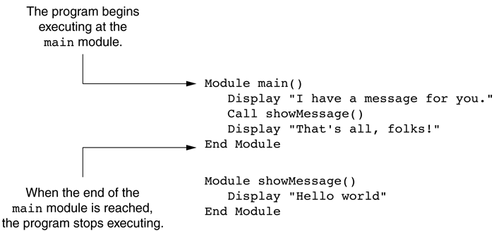
Defining and Calling a Module
A call must be made to the module in order for the statements in the body to execute.
The main module
Gaddis, T., Starting Out With Programming Logic and Design, 5 ed, ISBN: 978-0-13-480115-5

Slide 14
Defining and Calling a Module
A top-down design is used to break down an algorithm into modules by the following steps:
The overall task is broken down into a series of subtasks.
Each of the subtasks is repeatedly examined to determine if it can be further broken down.
Each subtask is coded.
Gaddis, T., Starting Out With Programming Logic and Design, 5 ed, ISBN: 978-0-13-480115-5

Slide 15
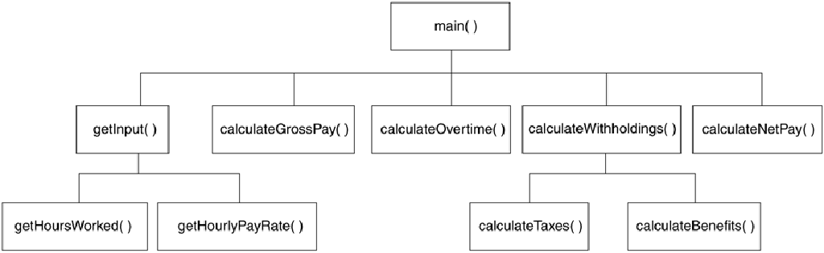
Defining and Calling a Module
A hierarchy chart gives a visual representation of the relationship between modules.
The details of the program are excluded.
A hierarchy chart
Gaddis, T., Starting Out With Programming Logic and Design, 5 ed, ISBN: 978-0-13-480115-5

Slide 16
Local Variables
A local variable is declared inside a module and cannot be accessed by statements that are outside the module.
Scope describes the part of the program in which a variable can be accessed.
Variables with the same scope must have different names.
Gaddis, T., Starting Out With Programming Logic and Design, 5 ed, ISBN: 978-0-13-480115-5

Slide 17
Passing Arguments to Modules
Sometimes, one or more pieces of data need to be sent to a module.
An argument is any piece of data that is passed into a module when the module is called.
A parameter is a variable that receives an argument that is passed into a module.
The argument and the receiving parameter variable must be of the same data type.
Multiple arguments can be passed sequentially into a parameter list.
Gaddis, T., Starting Out With Programming Logic and Design, 5 ed, ISBN: 978-0-13-480115-5

Slide 18
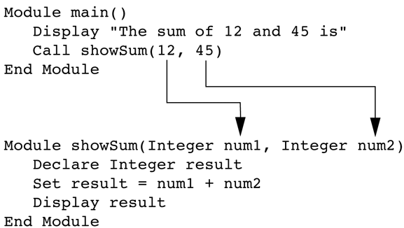
Passing Arguments to Modules
Two arguments passed into two parameters
Gaddis, T., Starting Out With Programming Logic and Design, 5 ed, ISBN: 978-0-13-480115-5

Slide 19
Passing Arguments to Modules
Pass by Value vs. Pass by Reference
Pass by Value means that only a copy of the argument’s value is passed into the module.
One-directional communication: Calling module can only communicate with the called module.
Pass by Reference means that the argument is passed into a reference variable.
Two-way communication: Calling module can communicate with called module; and called module can modify the value of the argument.
Gaddis, T., Starting Out With Programming Logic and Design, 5 ed, ISBN: 978-0-13-480115-5

Slide 20
Global Variables & Global Constants
A global variable is accessible to all modules.
Should be avoided because:
They make debugging difficult
Making the module dependent on global variables makes it hard to reuse module in other programs
They make a program hard to understand
Gaddis, T., Starting Out With Programming Logic and Design, 5 ed, ISBN: 978-0-13-480115-5

Slide 21
Global Variables & Global Constants
A global constant is a named constant that is available to every module in the program.
Since a program cannot modify the value of a constant, these are safer than global variables.
Gaddis, T., Starting Out With Programming Logic and Design, 5 ed, ISBN: 978-0-13-480115-5

Slide 22
Example
The Domestic Gas Supply Company records its customers’ gas usage figures on a customer usage file. Each record on the file contains the customer’s number, name, address, and gas usage expressed in cubic metres. Design a solution algorithm that will read the customer usage file, calculate the amount owing for gas usage for each customer, and then print a report listing each customer’s number, name, address, gas usage and the amount owing
The company bills its customers according to the following rate : if the customer’s usage is 60 cubic metres or less, a rate of $2.00 per cubic metre is applied; if the customer’s usage is more than 60 cubic metres, than a rate of $1.75 per cubic metre is applied for the first 60 cubic metres and $1.50 per cubic metre for the remaining usage
At the end of the report, print the total number of customers and the total amount owing to the company

Slide 23
Example
Define the problem
B. Group the activities into modules
Four modules will be used in the solution algorithm:
A module to perform some initial processing before loop
A module to calculate the amount owing for each customer
A module to print the customer details
A module to print the totals after exiting the loop
Input | Process | Output
customer usage records customer_number name address gas_usage | Print heading Read usage records Calculate amount owing Print customer details Compute total customers Compute total amount owing Print totals | Heading line Customer details customer_number name address gas_usage amount_owing total_customers total_amount_owing

Slide 24
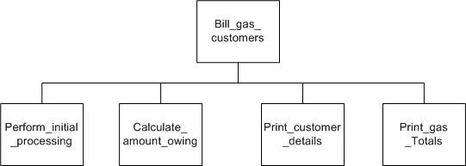
Example
C. Construct a hierarchy chart

Slide 25
Example
D. Establish the logic of the mainline of the algorithm, using pseudocode
MODULE Bill_gas_customers()
1 Perform_initial_processing()
2 READ customer_record
3 WHILE more records
4 Calculate_amount_owing()
5 Print_customer_details()
6 READ customer_record
ENDWHILE
7 Print_gas_totals()
END

Slide 26
Example
E. Develop the pseudocode for each successive module in the hierarchy chart
MODULE Perform_initial_processing()
8 print ‘CUSTOMER USAGE FIGURES’ heading
9 total_customer = 0
10 total_amount_owing = 0
END
MODULE Calculate_amount_owing()
11 IF usage <= 60 THEN
amount_owing = usage * $2.00
ELSE
amount_owing=(60*1.75)+((usage - 60)*$1.50)
ENDIF
12 total_amount_owing = total_amount_owing + amount_owing
END

Slide 27
Example
E. Develop the pseudocode for each successive module in the hierarchy chart
MODULE Print_customer_details()
13 PRINT customer_number, name, address, gas_usage, amount_owing
14 total_customers = total_customers + 1
END
MODULE Print_gas_totals()
15 PRINT total_customers
16 PRINT total_amount_owing
END

Slide 28
Example
F. Desk Check the solution algorithm
Input data
three test cases will be used to test the algorithm
Customer record | Gas_usage(cubic metres)
customer 1 | 40
customer2 | 61
customer3 | 80
EOF

Slide 29
Example
F. Desk Check the solution algorithm
2. Expected results

Slide 30
Example
F. Desk Checking the solution algorithm
3. Desk check table

Slide 31
References
Gaddis, T. (2019). Starting Out with Programming Logic and Design 5th. ISBN: 978-0-13-480115-5

